Slide 1
Flexing about Flexbox
Dr. MJ Uddin

Slide 2
CSS Flexbox

Slide 3
Flexbox
The “Flexible Box” or “Flexbox” layout mode offers an alternative to Floats for defining the overall appearance of a web page.
For the last decade or so, floats were the sole option for laying out a complex web page. This means you’ll inevitably run into floats during your web development career.
Whereas floats only let us horizontally position our boxes, flexbox gives us complete control over the alignment, direction, order, and size of our boxes.

Slide 4
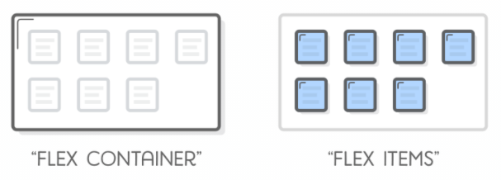
Flexbox
Flexbox uses two types of boxes that we’ve never seen before: “flex containers” and “flex items”.
The job of a flex container is to group a bunch of flex items together and define how they’re positioned.

Slide 5
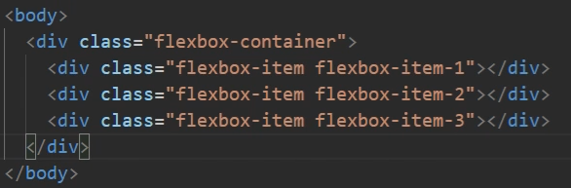
Flexbox
Let’s code this -

Slide 6
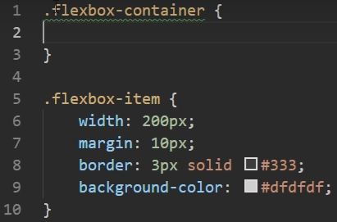
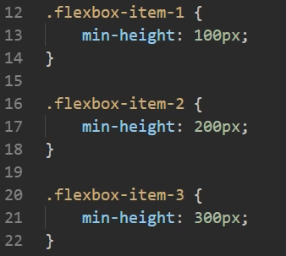
Flexbox
The CSS -

Slide 7
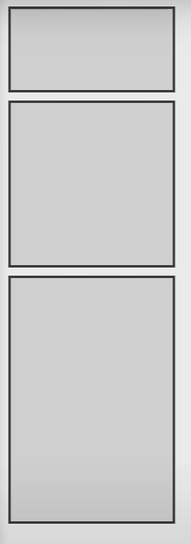
Flexbox
The output ->
Nothing fancy so far.

Slide 8

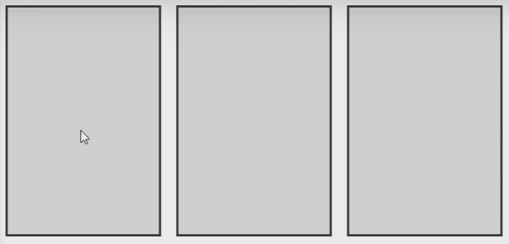
Flexbox
See what happens if we do this ->
All the boxes have aligned and stretched to the full height. The flexbox container is behaving as a row.
In addition, if we now scale the browser window, the boxes will shrink to fit in the window size.
If the window is large enough, they all show up in the left side of the screen

Slide 9
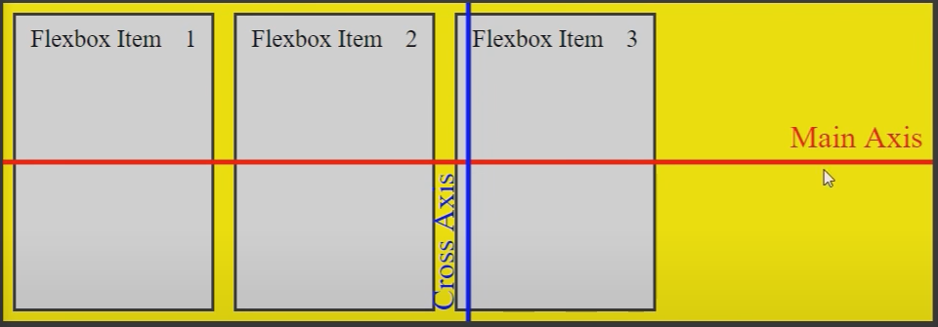
Flexbox
One of the biggest advantage is that we get to manipulate the placement of the flex items by styling the flex container.
Now before we proceed any further, we need to understand the concept of main axis and cross axis in the flex container.
By default, the flex container acts as a row, so the axes are as shown ->

Slide 10
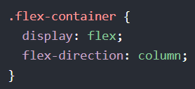
Flexbox
Doing this makes it behave as a column ->
Now the main axis is vertical and the cross axis is horizontal.
For the rest of the lecture, let’s keep flex-direction: row; This is the default value of flex-direction.

Slide 11
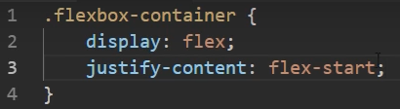
Flexbox: Main axis alignment
If we want to style the elements on the main axis, we would use the justify-content property.
Flex-start is the default value. It means the flex items will be laid at the start of the main axis

Slide 12
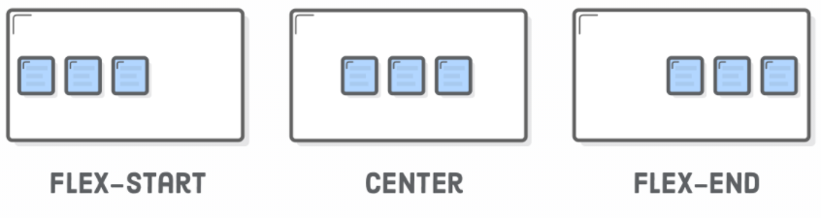
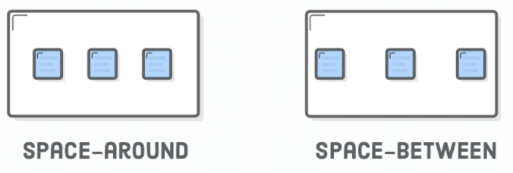
Flexbox: Main axis alignment
Other values of justify content are shown below -

Slide 13
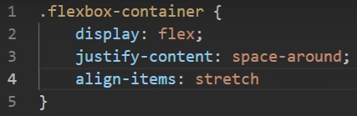
Flexbox: Cross axis alignment
If we want to lay out the items in the cross axis, we would use the align-items property.
This is the default value. This means the items will stretch to fill all available space in the cross axis

Slide 14
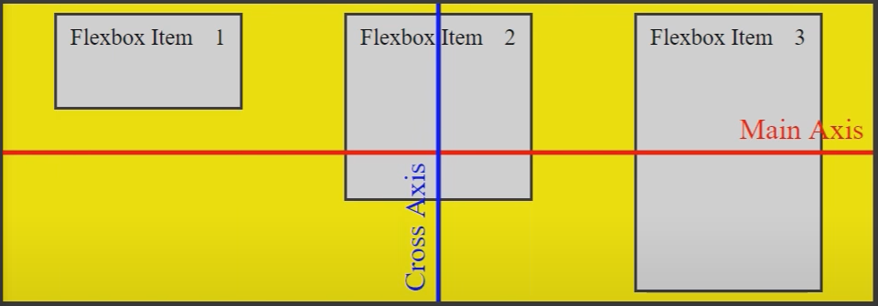
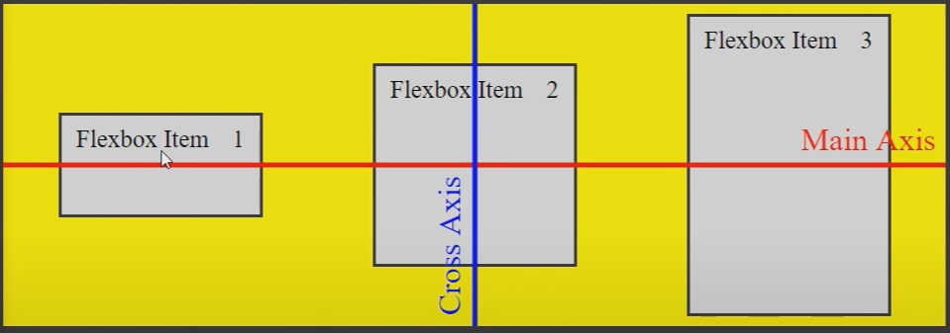
Flexbox: Cross axis alignment
Align-items: flex-start; ------>
Align-items: center; ------>

Slide 15
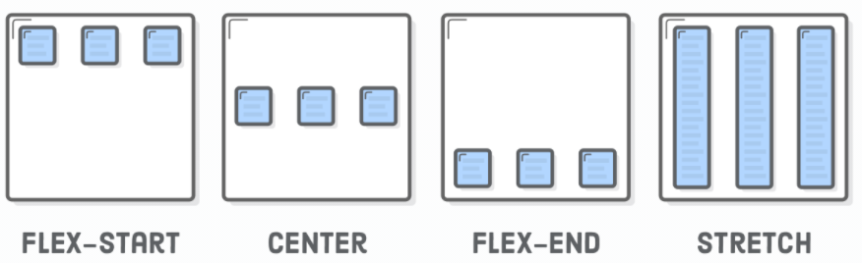
Flexbox
In summary

Slide 16
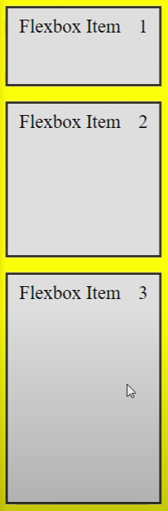
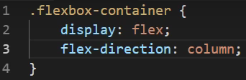
Flexbox
Need a column layout?
See how justify-content and align-items works now.
(You may need to change the height of the flex container.)
Notes:
s

Slide 17
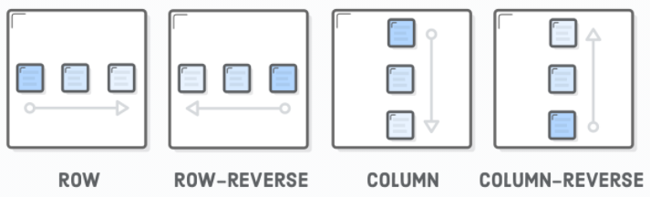
Flexbox
More about flex direction -
Notes:
s

Slide 18
Styling flex items

Slide 19
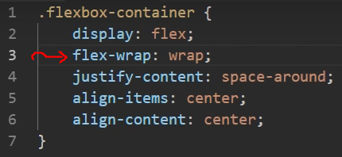
Flexbox
You might have noticed that flex items shrink when the screen size gets smaller. But they don’t expand when extra space is available.
Instead, if you want your items to be “wrapped” in multiple lines, then set this property to the flex container.

Slide 20
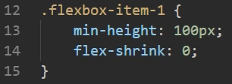
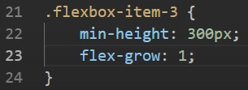
Flexbox
Alternatively, you can change that using flex-shrink and flex:grow properties on the flex items. Set the properties to 0 to turn them off or 1 to turn them on.

Slide 21
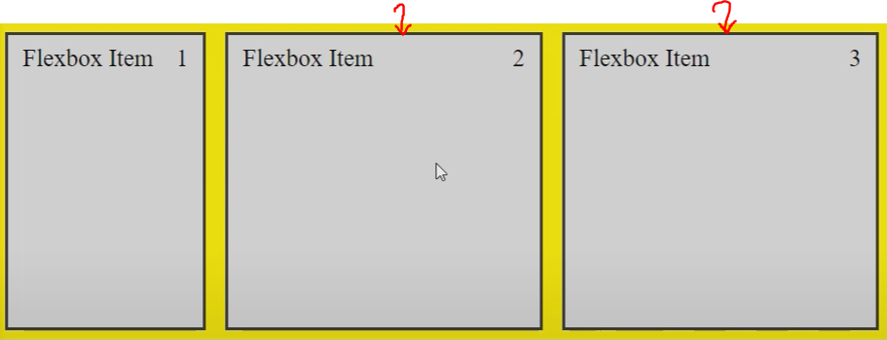
Flexbox
You can set flex-grow: 1 on multiple items. In that case, they will grow proportionally to one another.

Slide 22
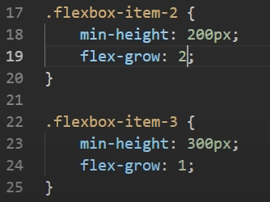
Flexbox
Doing this means that the remaining space will be divided unequally.
Item 2 will receive twice the amount of space as item 3.
But item 2 is not exactly twice of the size of item 3. It is because they both have a fixed initial size

Slide 23
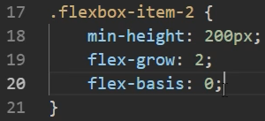
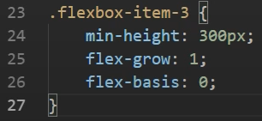
Flexbox
If you don’t like that, then do this ->
This tells where the flexbox item should be grown from. Setting flex-basis to 0 means it imagines the item is 0px wide and starts growing from there. Now item 2 will be exactly twice the size of item 3.

Slide 24
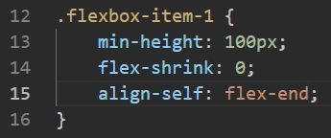
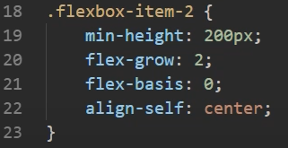
Flexbox
Align-self is another useful property if you want to override the alignment property as defined by the flex-container.

Slide 25
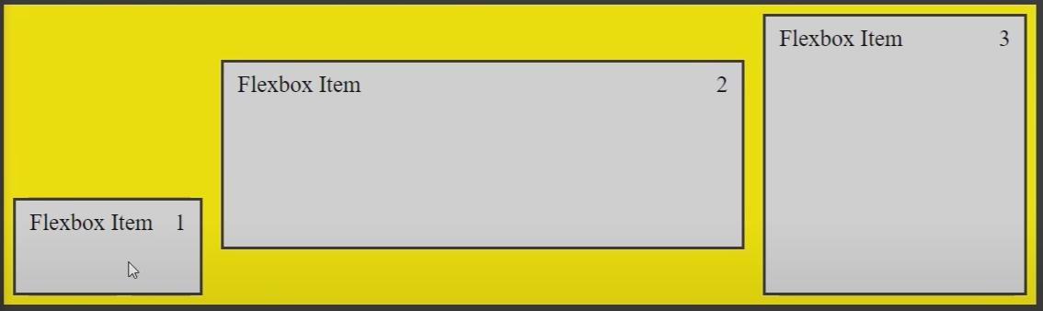
Flexbox
The result -

Slide 26

Flexbox
A useful shorthand for flex items -
The values stand for flex grow, shrink, and basis, respectively.
Simply typing flex: 1 automatically assigns 0 to shrink and basis as well.

Slide 27
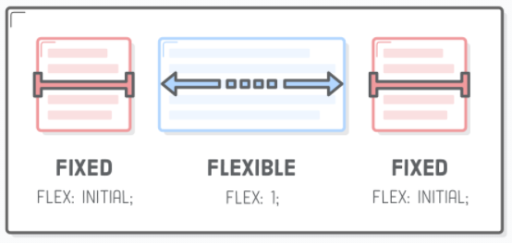
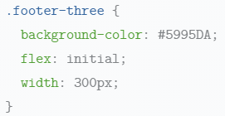
Flexbox
Set flex: initial for the item to have a static width.

Slide 28
Weekly Assignement

Slide 29
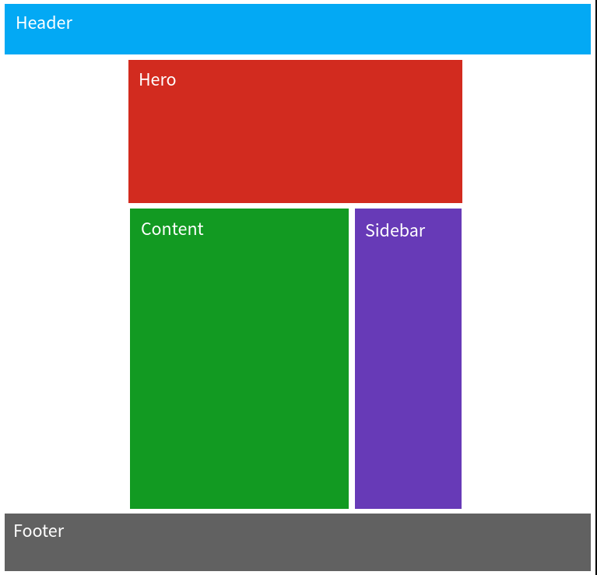
Task-1
Build a web page in this layout ->
The desktop view is shown on the right ->
Mobile and tablet view on the next page.

Slide 30
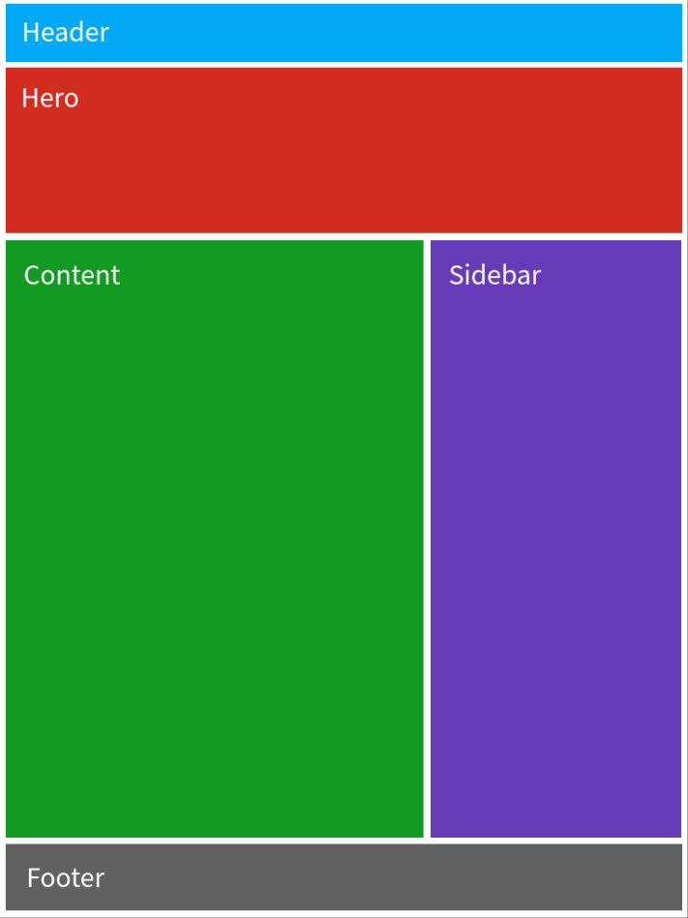
Task-1
Tablet view ->

Slide 31
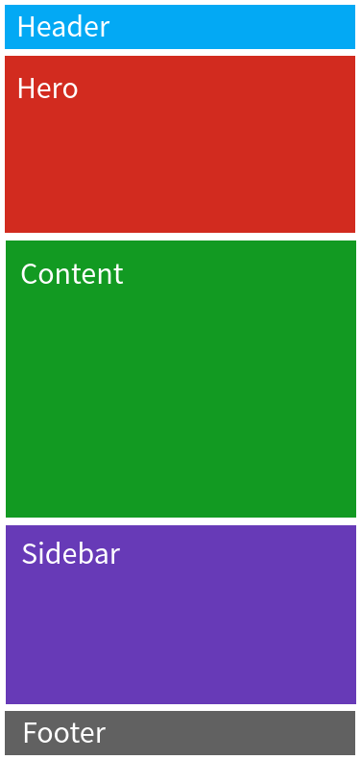
Task-1
Mobile view ->

Slide 32
Exercises
They may use some concepts / ideas that are new to you, and it’s okay.
This exercise is definitely solvable with what we have discussed in class.
All the best!

Slide 33
Task - 2
Make a website like this one - Styles Conference - Speakers
Be sure to make small changes to make it unique. For example, you can change the color scheme, the texts, the intent of the website i.e., what it is about, the photos, etc.
You can copy the main structure / layout of the website. It is simple, yet effective.
But if you decide to make a ditto copy of the website, it is still acceptable work, albeit a far less exciting one.

Slide 34
Thank you

